Slide 1



Getting started with Parkmobile’s API’s
Parkmobile Developers

Slide 2
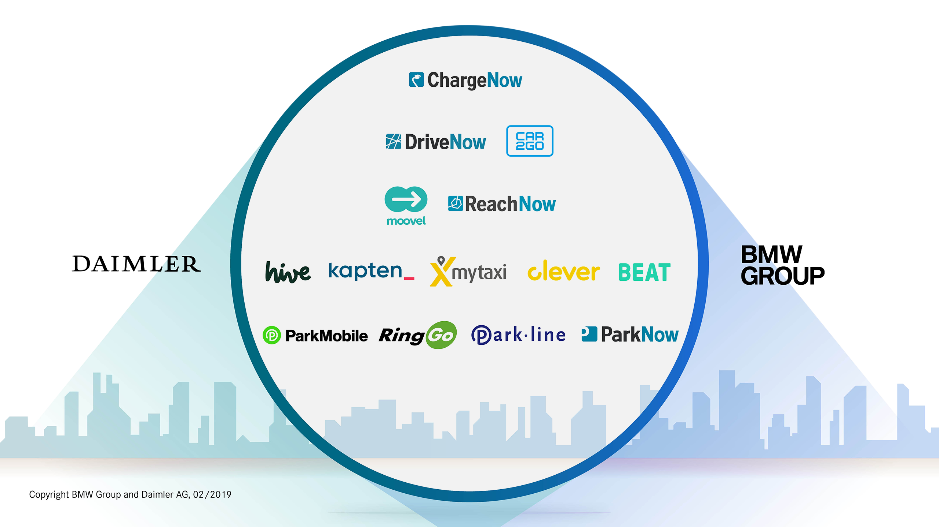
Notes:
Parkmobile AKA ParkNow, pat of mobility joint-venture between age old nemesis BMW & Daimler

Slide 3

WHO WE ARE
Maksym Koloshnyi
Yohanes Chandra
Rostyslav Skarbek
Fredrik Bonde
Hardik Yadav
Notes:
Where we want to move towards, more freedom

Slide 4

Services
Demo Time!
AGENDA
Workshop
Question ?

Slide 5

Inventory
Rates
Parking
Services
And more…..

Slide 6

Inventory
Our inventory service provides access to various on-and off-street parking locations as well as other points of interest that are relevant to our customers.

Slide 7
Inventory
Inventory consists of POIs (Points of Interest)
Example of POI’s
Parking Zones
Garages
Parking meters
Charging stations

Slide 8

Inventory
Search POI by location code
Search POI by GPS location
Notes:
Notes:
Add arrow pointing to the location code
Add remark about signage code = location code
Create separate slide per endpoint with according pictures
Lat/Lon : add picture charging point,

Slide 9
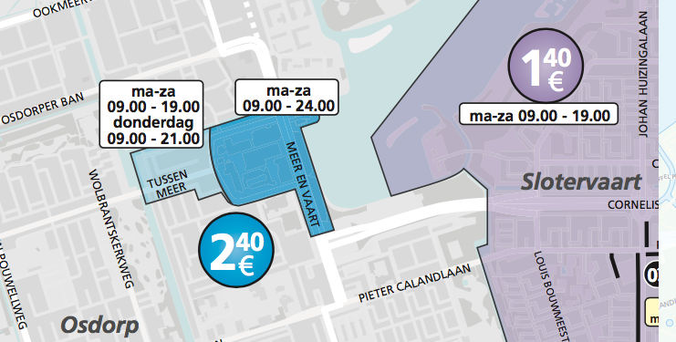
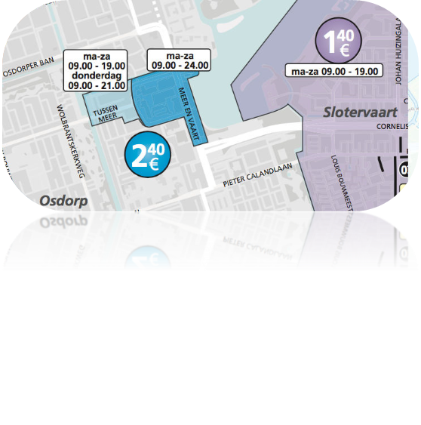
RATES
The Rates Service has a key responsibility:
Calculate exact price for a given parking session and zone.

Slide 10
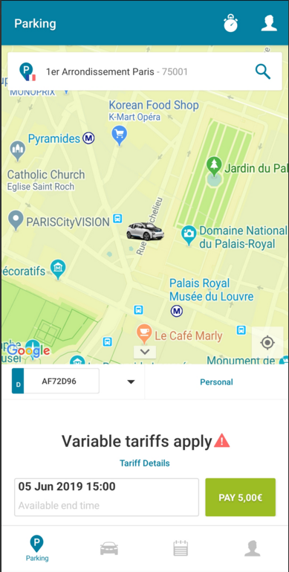
PARKING
Parking service allows you to
Start – stop parking action
Register parking right
Extend parking right
End parking right
Notes:
Add pictures and split up per end-points

Slide 11

DEMO TIME !
Notes:
DEMO:
1. Github

Slide 12

Brainstorm
Where can I find garage with available parking?
Where is the nearest charging station?
How can we reduce the CO2?
How can I get the cheapest parking spot?
How to optimize parking for autonomous cars?
How do I ensure that I’m not going to get fine?

Slide 13
QUESTIONS ?

Slide 14
links
Github - https://github.com/ParkmobileHackatrain/2019/
Here you can find :
Postman collection
Information about the API operations
Information about configuration
X-Api-Key

Slide 15

THANK YOU

